Slide 1


WRAP IT A vinyl-wrap design platform
By Group 7 – Will Keogh, Daniel Stevens, Daniel Taylor, and Samuel Stevens
Image generated through ChatGPT

Slide 2
Planning process
Original idea – Can design platform
Refined to vinyl design during pitch with Tyler
Originally designs only done through paint feature – AI added later

Slide 3
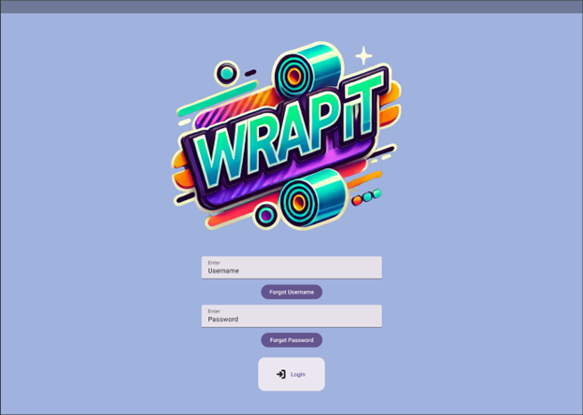
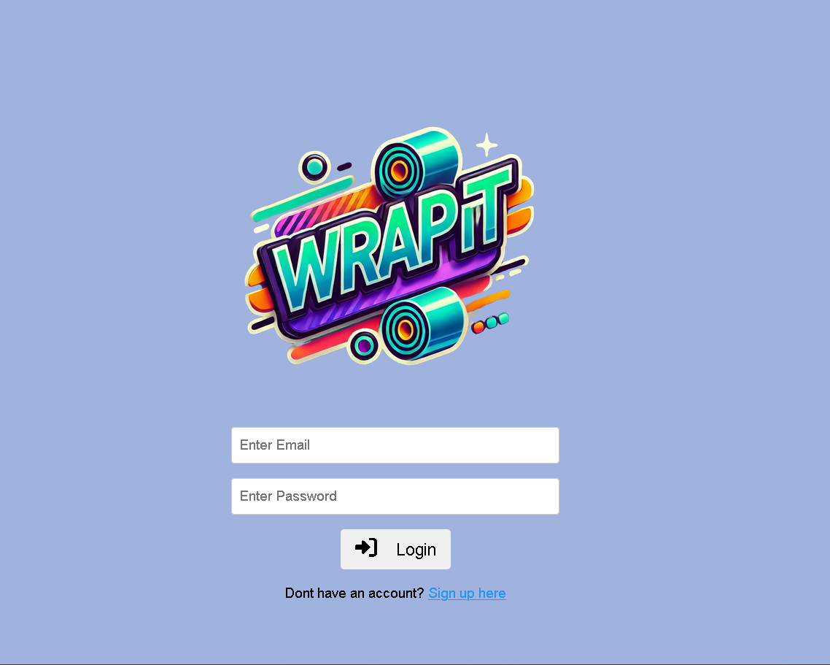
Design iteration
Login Screen

Slide 4
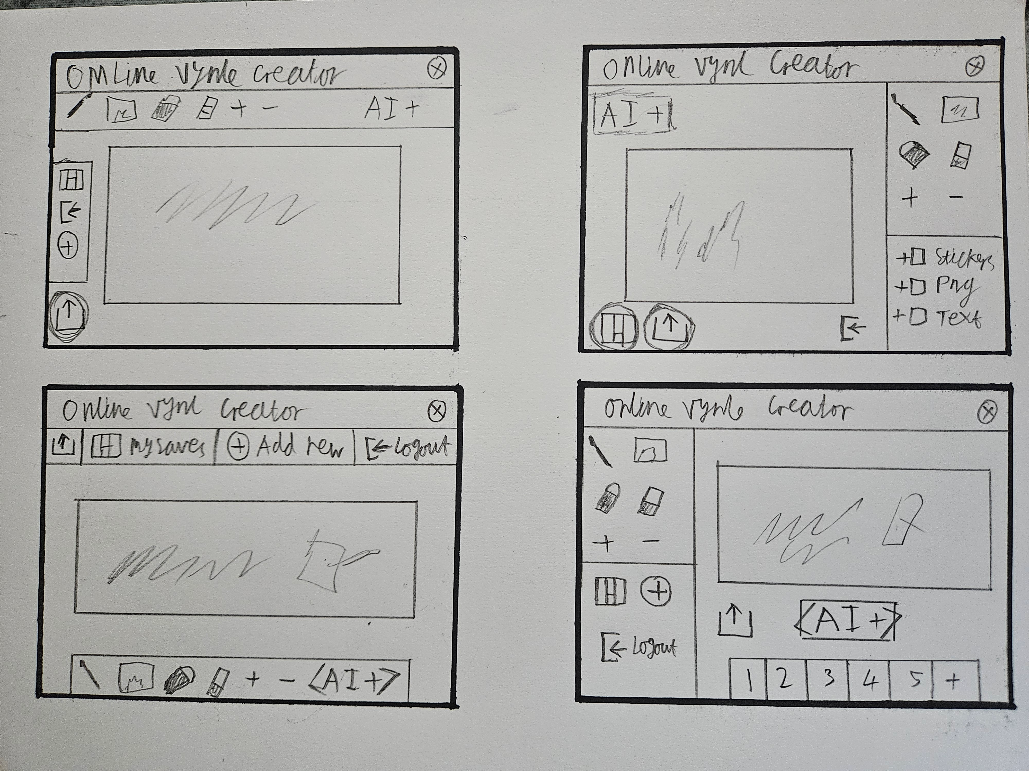
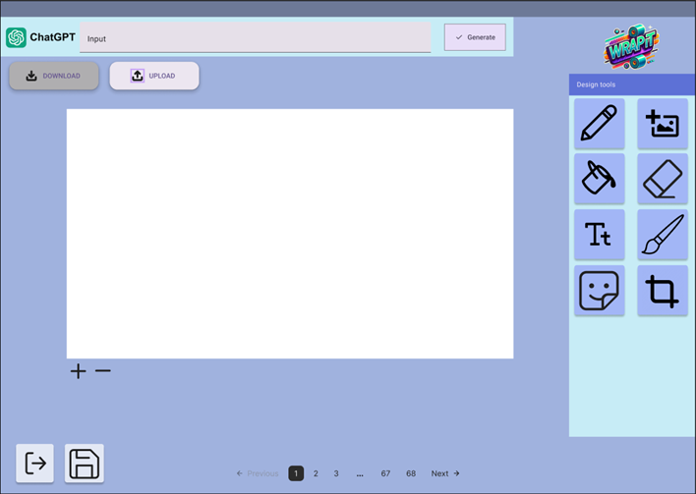
Design iteration
Main design platform

Slide 5
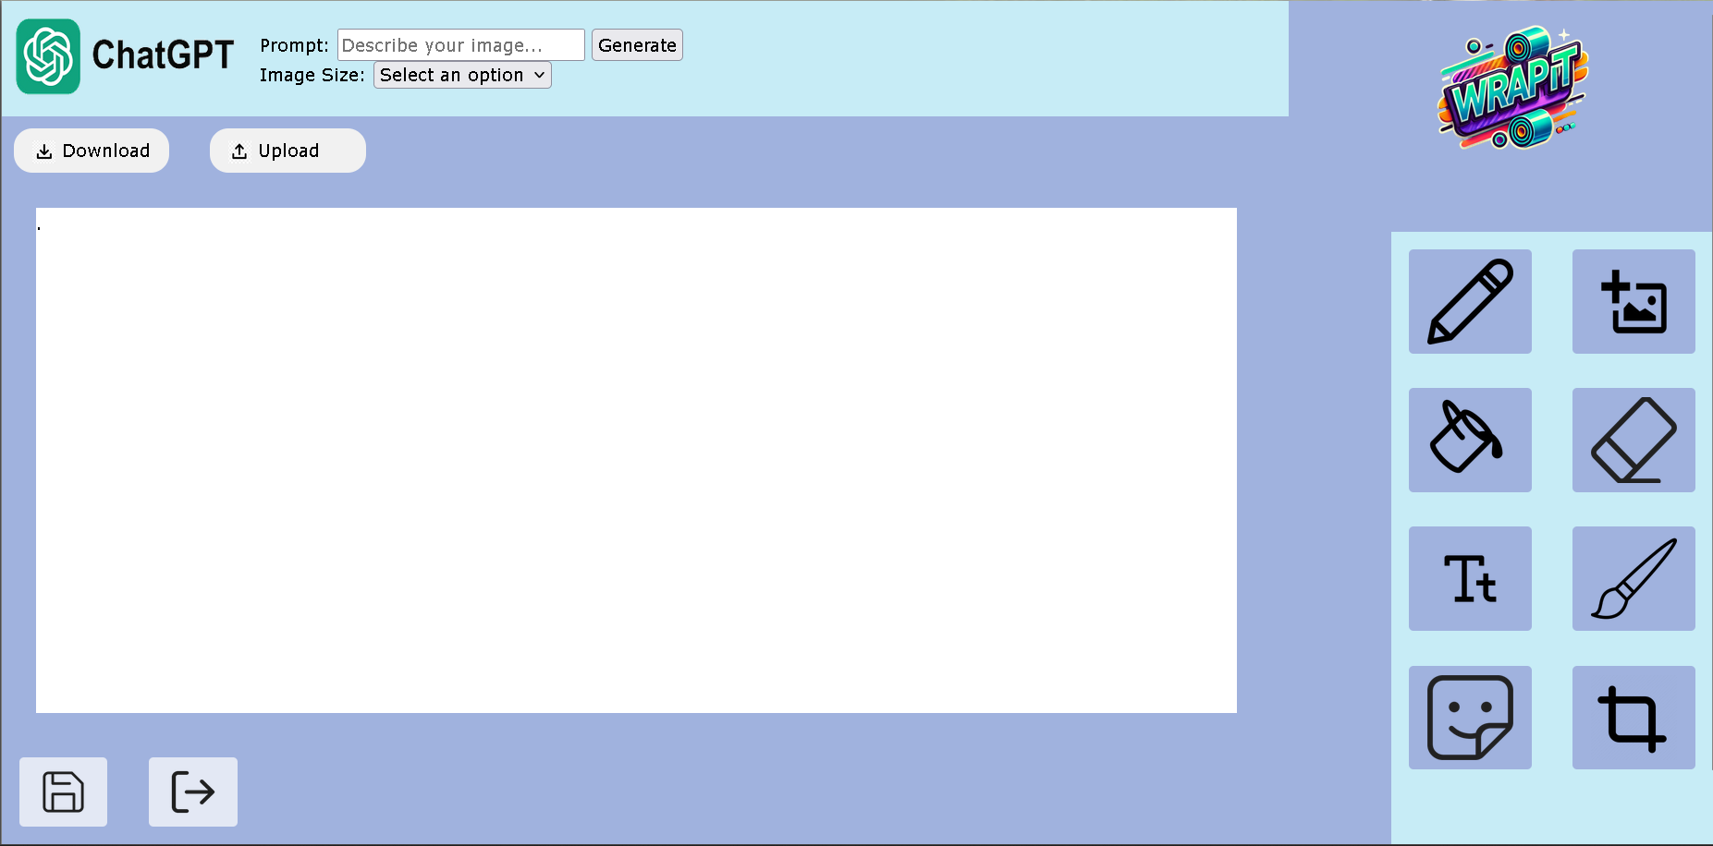
Design iteration
Main Design page Cont.

Slide 6
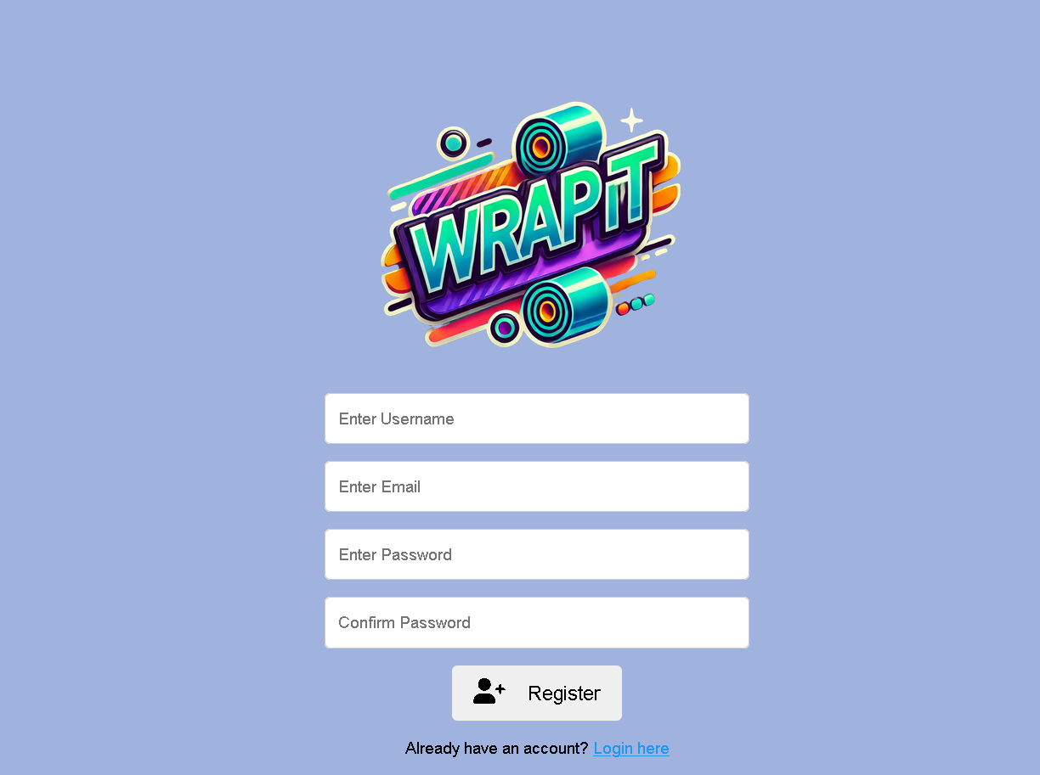
Requirements
Users must be able to create accounts and log in
Account creation
Log-in screen
Familiar to users
Simple design

Slide 7
Requirements
Users can use AI to generate a design
Users can use a paint-like tool to create their designs
Users can save their designs
(Non-functional)
Large design space
Intuitive use
Accessibility

Slide 8

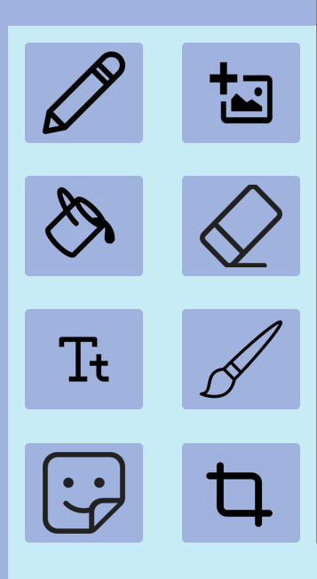

This semester
Implement paint feature
Refine paint tool buttons
Implement working save and logout buttons
Add functionality for uploading images
Password strength checker
https://commons.wikimedia.org/wiki/File:Microsoft_Paint.svg

